Slide 1
CSE 280
Identifying multiple characteristics of graphs
Multiple Vertices, Edges, Cross Over, Labeling

Slide 2
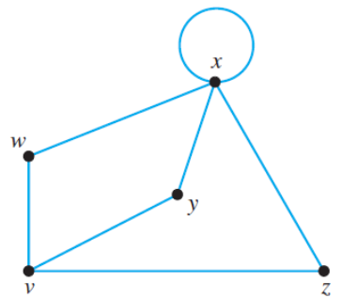
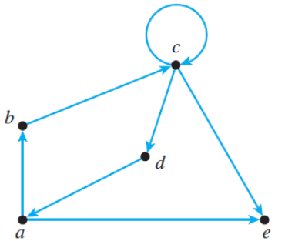
Some terminology
Directed vs undirected
Node/vertex
Link/edge
Degree of a vertex
Indegree
Outdegree
Path (vertices)
Circuit / Cycle (edge)
Connected
Loop
Hunter, David J. Essentials of Discrete Mathematics, 3rd Edition. Jones & Bartlett Learning 2017

Slide 3


Some terminology
$G=\left(\left\{A, B, C, D\right\}, \left\{\left\{A,B\right\}, \left\{A,C\right\}, \left\{B,C\right\}, \left\{C,D\right\}\right\}\right)$
Vertices
$$\sum_{v∈V}{\deg\left(v\right)=2⋅\left|E\right|}$$
Edges
Handshaking
In/Out degrees
Directed/Undirected
Links
Circuit/ Path/Cycle
Walk/Trail
Connected
Loop
Adjacency List (Neighbors)
Trees/Graph
Incident/connects
Endpoints
Multi-graph - pairs
Completed
K-vertex conn.
K-edge conn.

Slide 4
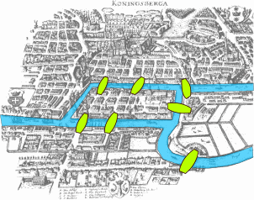
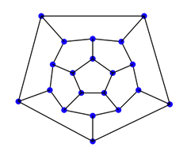
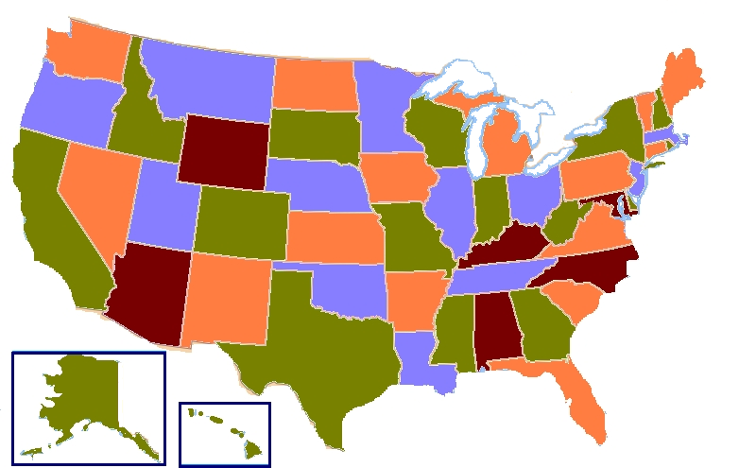
Euler Circuits
Hamiltonian Cycles
Bipartite Graph
Coloring Graphs
Chromatic Number
A
F
D
B
E
C

Slide 5
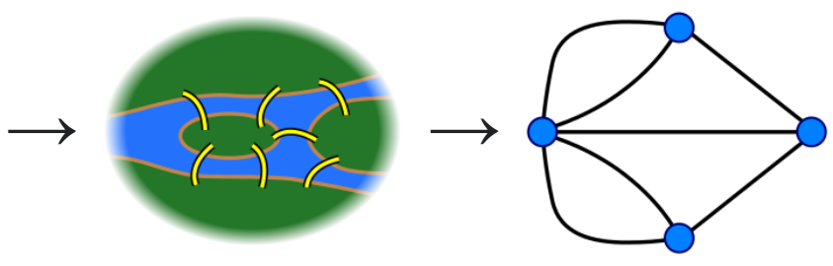
Euler Circuits
An Euler circuit is a circuit that contains every edge and every vertex.
No edges are repeated.
Seven Bridges of Königsberg
Can you find an Euler circuit in this graph?

Slide 6
Euler Circuits
What are some examples of graphs in which we would want to visit every edge once and only once?
Plowing roads (vertices are intersections and roads are edges)
Mail delivery

Slide 7
Euler Circuits
A circuit has no repeated edges.
If an undirected graph G has an Euler circuit, then G is connected and every vertex in G has an even degree.
If a graph has a vertex with an odd degree, then the graph cannot have an Euler circuit.
If an undirected graph G is connected and every vertex in G has an even degree, then G has an Euler circuit.
Try to find an Euler circuit in this graph:
An undirected graph G has an Euler circuit if and only if G is connected and every vertex in G has even degree.
Start at a.
d
If we start at a, we must end at a because it is a circuit.
a
b
c
But if we leave a, then come back to a, there is still one more edge we haven't traversed.
e
If we traverse that last edge, we are not longer ending at a, so it is not a circuit.

Slide 8
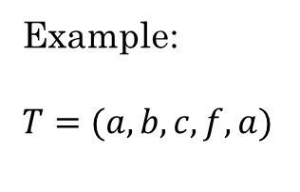
Finding a circuit in a graph
All vertices must have even degree.
Find a vertex w, that is not an isolated vertex.
Select any edge {w, x} incident to w. (Since w is not isolated, there is always at least one such edge.)
Current trail T := ⟨w, x⟩ last := x
While there is an edge {last, y} that has not been used in T: Add y to the end of T last := y
a
b
f
c
d
e
Example:
$T=(a,b,c,f,a)$

Slide 9
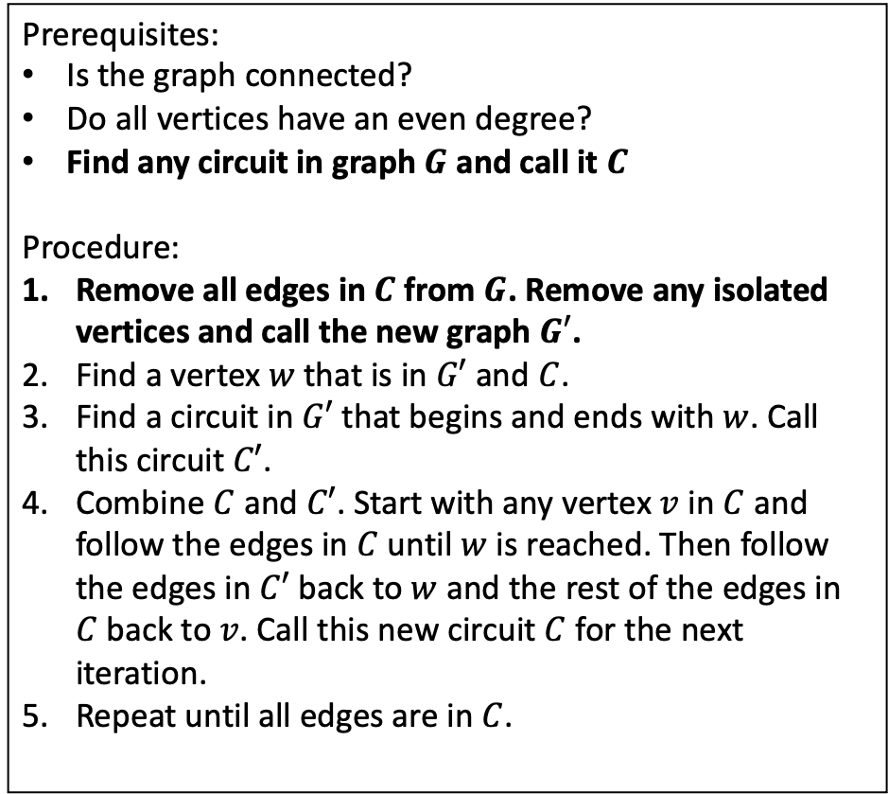
Finding an Euler Circuit in a graph
Prerequisites:
Is the graph connected?
Do all vertices have an even degree?
Find any circuit in graph $G$ and call it $C$
Procedure:
Remove all edges in $C$ from $G$. Remove any isolated vertices and call the new graph $G′$.
Find a vertex $w$ that is in $G′$ and $C$.
Find a circuit in $G′$ that begins and ends with $w$. Call this circuit $C′$.
Combine $C$ and $C′$. Start with any vertex $v$ in $C$ and follow the edges in $C$ until $w$ is reached. Then follow the edges in $C′$ back to $w$ and the rest of the edges in $C$ back to $v$. Call this new circuit $C$ for the next iteration.
Repeat until all edges are in $C$.
Find a Euler Circuit by tracing the algorithm in on the following graph:
a
b
c
d
e

Slide 10
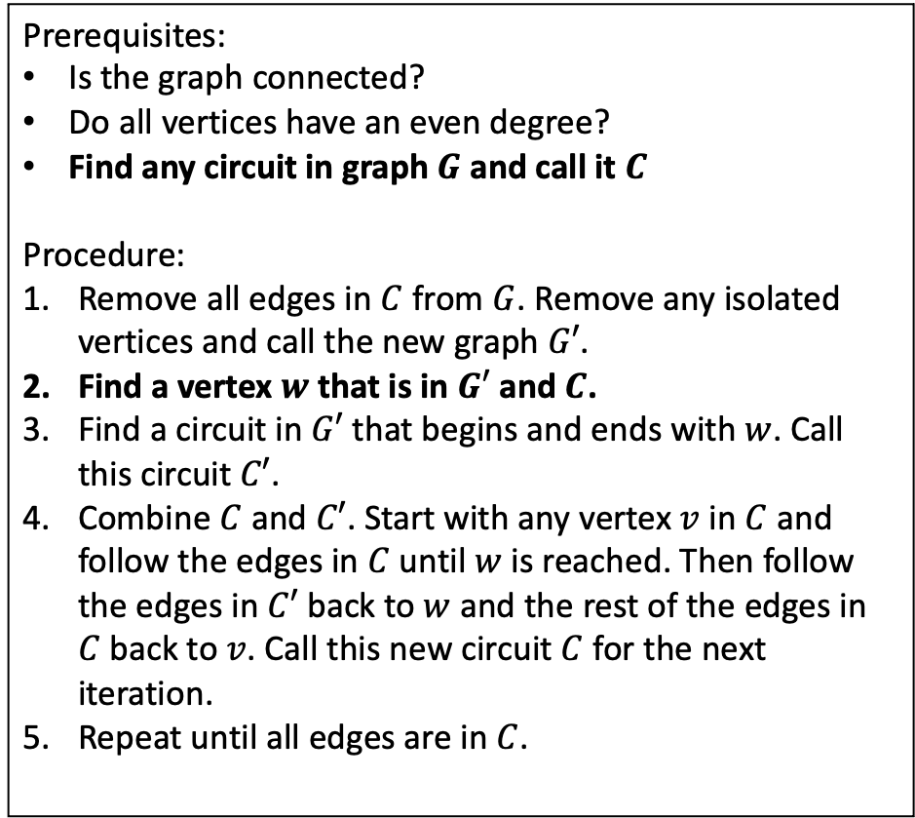
Finding an Euler Circuit in a graph
Prerequisites:
Is the graph connected?
Do all vertices have an even degree?
Find any circuit in graph $G$ and call it $C$
Procedure:
Remove all edges in $C$ from $G$. Remove any isolated vertices and call the new graph $G′$.
Find a vertex $w$ that is in $G′$ and $C$.
Find a circuit in $G′$ that begins and ends with $w$. Call this circuit $C′$.
Combine $C$ and $C′$. Start with any vertex $v$ in $C$ and follow the edges in $C$ until $w$ is reached. Then follow the edges in $C′$ back to $w$ and the rest of the edges in $C$ back to $v$. Call this new circuit $C$ for the next iteration.
Repeat until all edges are in $C$.
Find a Euler Circuit by tracing the algorithm in on the following graph:
a
b
c
d
e
C = (a, b, c, a)

Slide 11
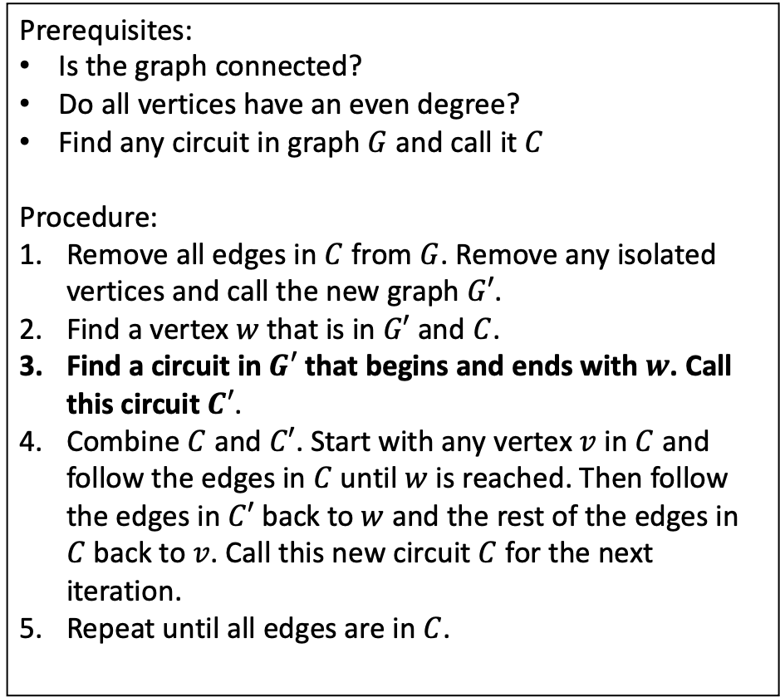
Finding an Euler Circuit in a graph
Find a Euler Circuit by tracing the algorithm in on the following graph:
Prerequisites:
Is the graph connected?
Do all vertices have an even degree?
Find any circuit in graph $G$ and call it $C$
Procedure:
Remove all edges in $C$ from $G$. Remove any isolated vertices and call the new graph $G′$.
Find a vertex $w$ that is in $G′$ and $C$.
Find a circuit in $G′$ that begins and ends with $w$. Call this circuit $C′$.
Combine $C$ and $C′$. Start with any vertex $v$ in $C$ and follow the edges in $C$ until $w$ is reached. Then follow the edges in $C′$ back to $w$ and the rest of the edges in $C$ back to $v$. Call this new circuit $C$ for the next iteration.
Repeat until all edges are in $C$.
a
b
c
d
C = (a, b, c, a)
e
C' = (a, d, e, a)

Slide 12
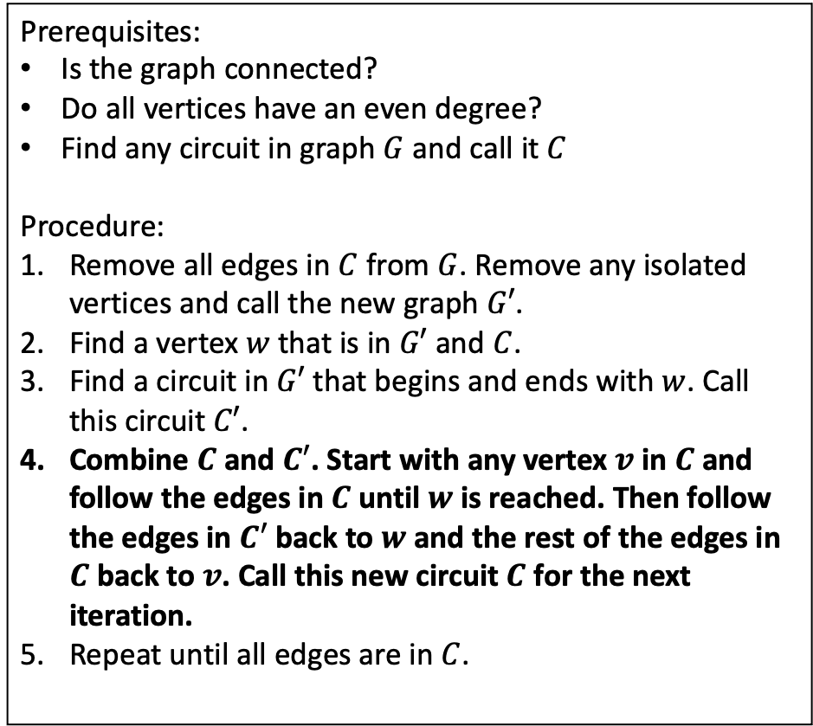
Finding an Euler Circuit in a graph
Prerequisites:
Is the graph connected?
Do all vertices have an even degree?
Find any circuit in graph $G$ and call it $C$
Procedure:
Remove all edges in $C$ from $G$. Remove any isolated vertices and call the new graph $G′$.
Find a vertex $w$ that is in $G′$ and $C$.
Find a circuit in $G′$ that begins and ends with $w$. Call this circuit $C′$.
Combine $C$ and $C′$. Start with any vertex $v$ in $C$ and follow the edges in $C$ until $w$ is reached. Then follow the edges in $C′$ back to $w$ and the rest of the edges in $C$ back to $v$. Call this new circuit $C$ for the next iteration.
Repeat until all edges are in $C$.
Find a Euler Circuit by tracing the algorithm in 13.6.3 on the following graph:
a
b
c
d
e
C = (a, b, c, a)
C = (a, d, e, a, b, c, a)
C' = (a, d, e, a)

Slide 13
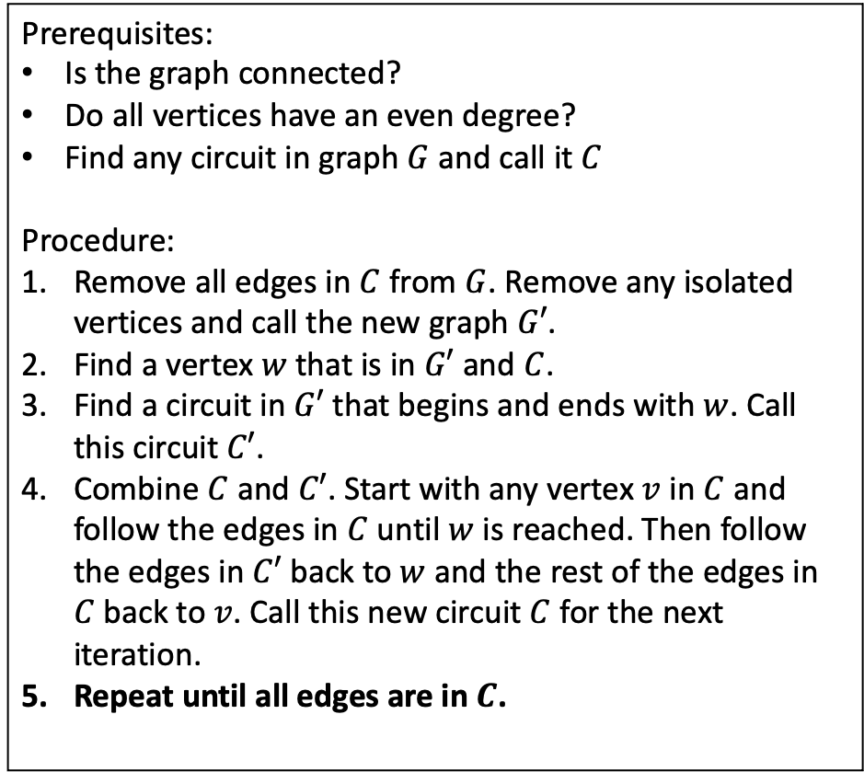
Finding an Euler Circuit in a graph
Prerequisites:
Is the graph connected?
Do all vertices have an even degree?
Find any circuit in graph $G$ and call it $C$
Procedure:
Remove all edges in $C$ from $G$. Remove any isolated vertices and call the new graph $G′$.
Find a vertex $w$ that is in $G′$ and $C$.
Find a circuit in $G′$ that begins and ends with $w$. Call this circuit $C′$.
Combine $C$ and $C′$. Start with any vertex $v$ in $C$ and follow the edges in $C$ until $w$ is reached. Then follow the edges in $C′$ back to $w$ and the rest of the edges in $C$ back to $v$. Call this new circuit $C$ for the next iteration.
Repeat until all edges are in $C$.
Find a Euler Circuit by tracing the algorithm in on the following graph:
a
b
c
d
e
C = (a, d, e, a, b, c, a)

Slide 14
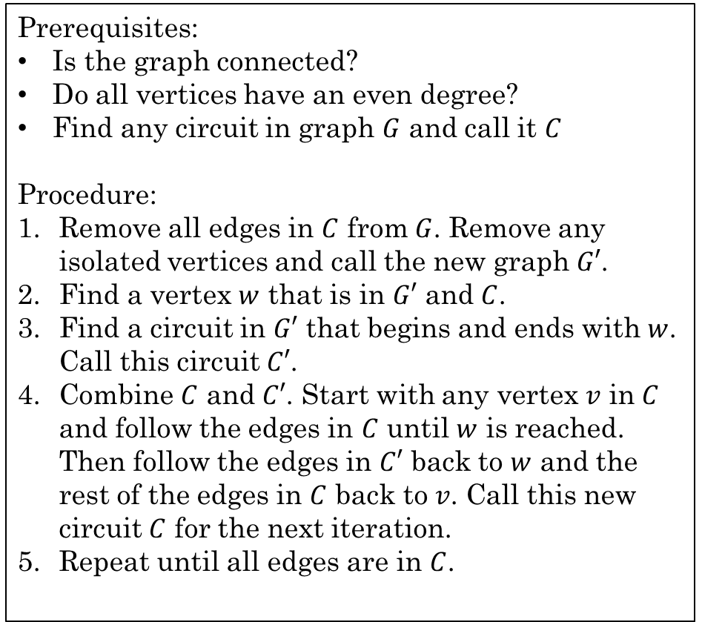
Finding an Euler Circuit in a graph
Prerequisites:
Is the graph connected?
Do all vertices have an even degree?
Find any circuit in graph $G$ and call it $C$
Procedure:
Remove all edges in $C$ from $G$. Remove any isolated vertices and call the new graph $G′$.
Find a vertex $w$ that is in $G′$ and $C$.
Find a circuit in $G′$ that begins and ends with $w$. Call this circuit $C′$.
Combine $C$ and $C′$. Start with any vertex $v$ in $C$ and follow the edges in $C$ until $w$ is reached. Then follow the edges in $C′$ back to $w$ and the rest of the edges in $C$ back to $v$. Call this new circuit $C$ for the next iteration.
Repeat until all edges are in $C$.
Find a Euler Circuit by tracing the algorithm in on the following graph:
a
b
c
d
e
C = (a, d, e, a, b, c, a)
C' = (b, d, c, e, b)

Slide 15
Finding an Euler Circuit in a graph
Find a Euler Circuit by tracing the algorithm in on the following graph:
Prerequisites:
Is the graph connected?
Do all vertices have an even degree?
Find any circuit in graph $G$ and call it $C$
Procedure:
Remove all edges in $C$ from $G$. Remove any isolated vertices and call the new graph $G′$.
Find a vertex $w$ that is in $G′$ and $C$.
Find a circuit in $G′$ that begins and ends with $w$. Call this circuit $C′$.
Combine $C$ and $C′$. Start with any vertex $v$ in $C$ and follow the edges in $C$ until $w$ is reached. Then follow the edges in $C′$ back to $w$ and the rest of the edges in $C$ back to $v$. Call this new circuit $C$ for the next iteration.
Repeat until all edges are in $C$.
a
b
c
d
e
C = (a, d, e, a, b, c, a)
C' = (b, d, c, e, b)
C = (a, d, e, a, b, d, c, e, b, c, a)

Slide 16
Finding an Euler Circuit in a graph
Find a Euler Circuit by tracing the algorithm in on the following graph:
Prerequisites:
Is the graph connected?
Do all vertices have an even degree?
Find any circuit in graph $G$ and call it $C$
Procedure:
Remove all edges in $C$ from $G$. Remove any isolated vertices and call the new graph $G′$.
Find a vertex $w$ that is in $G′$ and $C$.
Find a circuit in $G′$ that begins and ends with $w$. Call this circuit $C′$.
Combine $C$ and $C′$. Start with any vertex $v$ in $C$ and follow the edges in $C$ until $w$ is reached. Then follow the edges in $C′$ back to $w$ and the rest of the edges in $C$ back to $v$. Call this new circuit $C$ for the next iteration.
Repeat until all edges are in $C$.
a
b
c
d
e
C = (a, d, e, a, b, d, c, e, b, c, a)

Slide 17
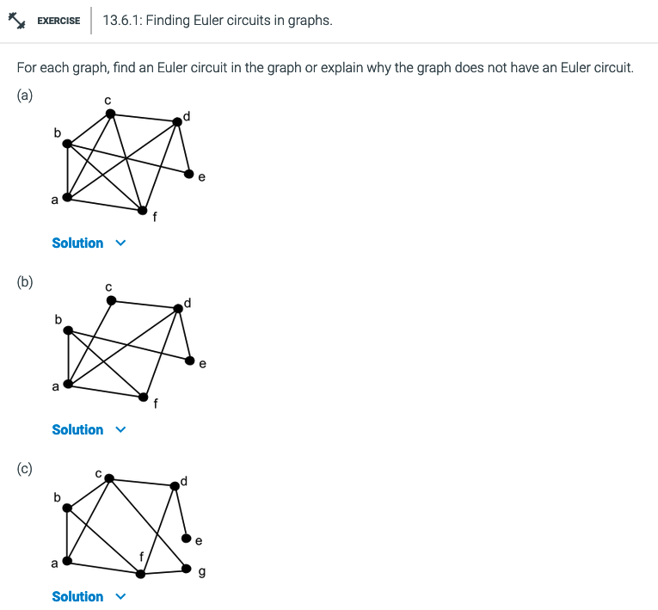
Additional Exercises
With a partner, do
13.6.1 a, b, c

Slide 18
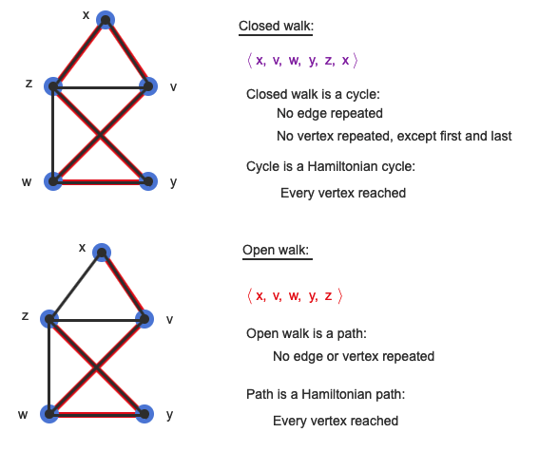
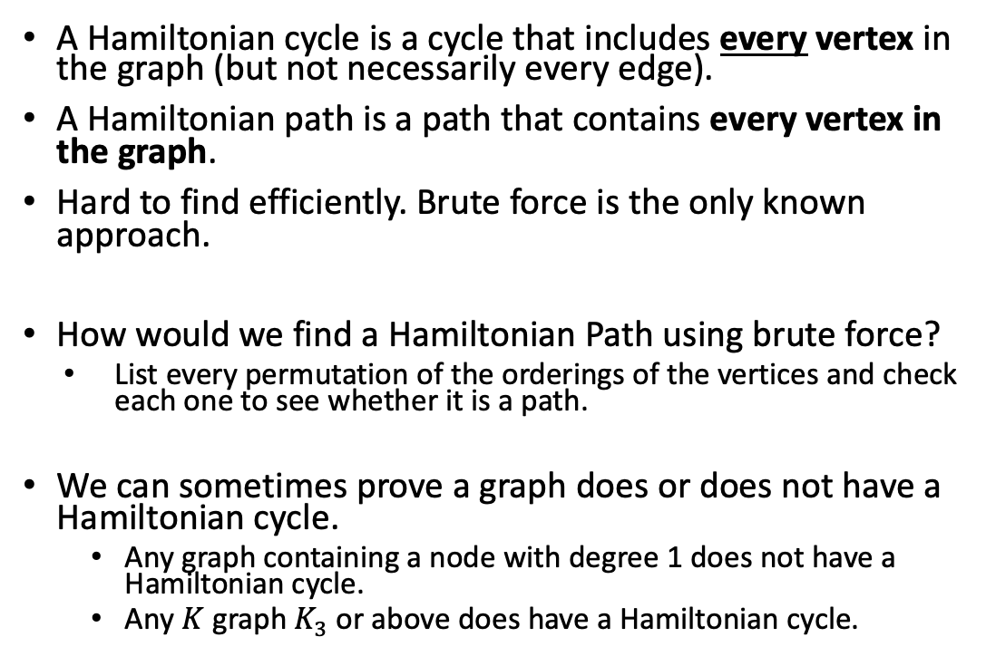
Hamiltonian Cycles
A cycle has no repeated edges or vertices.
A Hamiltonian cycle is a cycle that includes every vertex in the graph (but not necessarily every edge).
A Hamiltonian path is a path that contains every vertex in the graph.
Hard to find efficiently. Brute force is the only known approach.
How would we find a Hamiltonian Path using brute force?
List every permutation of the orderings of the vertices and check each one to see whether it is a path.
We can sometimes prove a graph does or does not have a Hamiltonian cycle.
Any graph containing a node with degree 1 does not have a Hamiltonian cycle.
Any $K$ graph $K_{3}$ or above does have a Hamiltonian cycle.

Slide 19
Hamiltonian Cycles
Hamiltonian cycles are named after William Rowan Hamilton who invented a game in 1857 to find a Hamiltonian cycle in the dodecahedral graph shown below.
What are some situations in which this would be useful?
UPS delivery. Stops are the vertices and edges are the roads (Don't need to visit every edge, but we do need to visit every vertex)
Traveling Salesman. The salesman wants to visit every city and get back home.

Slide 20
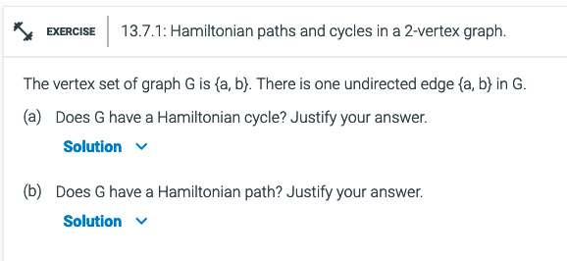
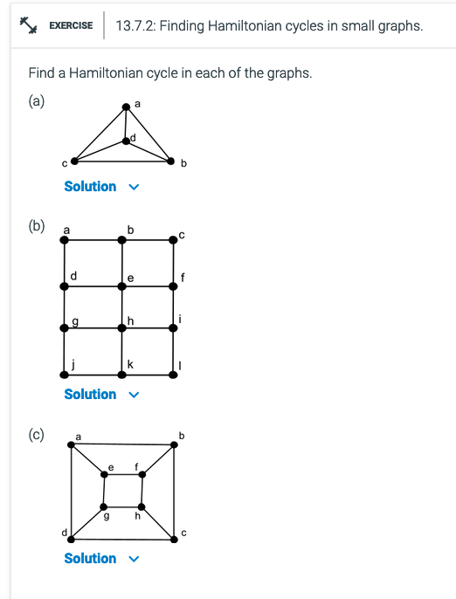
With a partner:
Do additional exercise 13.7.1 and 13.7.2

Slide 21
Bipartite Graph
The graph consists of two sub-graphs. Each element of each subgraph has adjacent nodes ONLY in the other sub-graph

Slide 22
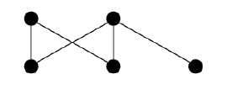
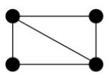
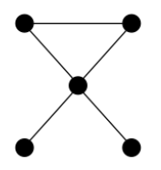
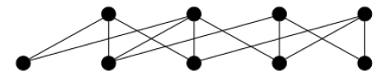
Bipartite Graphs
Examples of Bipartite
Tree
Cycle Graphs with even vertices
Planar Graphs w/even length
Can be divided into two sets of vertices such that none of the vertices in either set are connected by an edge
Example:
Bipartite
Not Bipartite

Slide 23
Bipartite Graphs
Can be used to model applications that involve matching elements of one set to elements of another
Example:
Customers and Products
Employees to job assignments
Students to classes
Marriages between men and women in a village

Slide 24
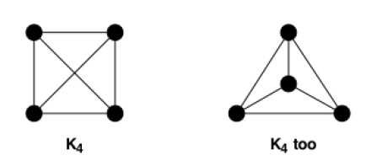
Planar Graphs
A graph that can be drawn without lines crossing
Planar?
Planar?
Note these are the same graph, just drawn differently

Slide 25
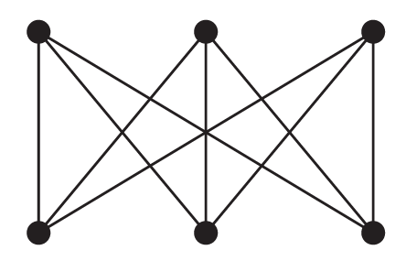


Planar Graphs
Example:
Is it possible to connect three houses to three utilities (e.g., electricity, fiber, gas) without the lines crossing?
Can you draw $K_{3,3}$ as a planar graph?
No, $K_{3,3}$ is not planar.
Levin, Oscar. Discrete Mathematics, An Open Introduction, 3rd Edition. 2021

Slide 26
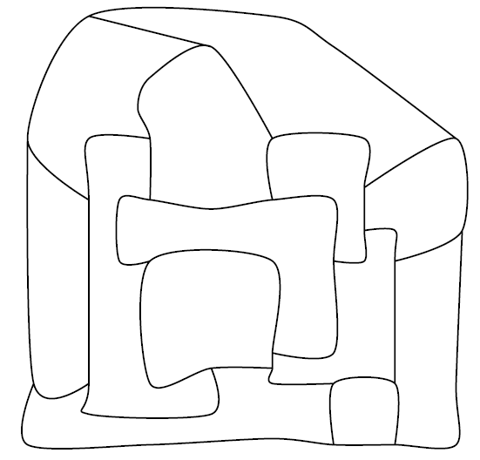
Coloring Graphs
Mapmakers in the fictional land of Euleria have drawn the borders of the various dukedoms of the land.
To make the map pretty, they wish to color each region. Adjacent regions must be colored differently, but it is perfectly fine to color two distant regions with the same color.
What is the fewest colors the mapmakers can use and still accomplish this task?
Levin, Oscar. Discrete Mathematics, An Open Introduction, 3rd Edition. 2021

Slide 27
Coloring Graphs
Mapmakers in the fictional land of Euleria have drawn the borders of the various dukedoms of the land.
To make the map pretty, they wish to color each region. Adjacent regions must be colored differently, but it is perfectly fine to color two distant regions with the same color.
What is the fewest colors the mapmakers can use and still accomplish this task?
A
B
C
D
G
J
F
E
H
K
L
I
M
Levin, Oscar. Discrete Mathematics, An Open Introduction, 3rd Edition. 2021

Slide 28
Coloring Graphs
B
A
B
A
A
B
C
C
C
G
D
G
D
G
D
J
J
J
F
E
F
F
E
E
H
K
H
K
L
H
K
L
L
I
M
I
M
I
M
Levin, Oscar. Discrete Mathematics, An Open Introduction, 3rd Edition. 2021

Slide 29
Coloring Graphs
Let's color the nodes using the greedy algorithm,
in alphabetical order.
B
B
A
B
A
A
C
C
D
G
C
J
J
J
D
E
D
E
G
F
G
E
F
F
L
H
K
L
L
K
H
K
H
I
M
M
I
M
I
Levin, Oscar. Discrete Mathematics, An Open Introduction, 3rd Edition. 2021

Slide 30

Coloring Graphs
The Four Color Theorem (proved in 1976), states that if a graph $G$ is planar, then its regions can be colored using 4 or fewer colors.
The current best proof requires computers to check 633 reducible configurations....not an easy proof.
Levin, Oscar. Discrete Mathematics, An Open Introduction, 3rd Edition. 2021

Slide 31
Chromatic Number
A
F
A
E
F
D
D
B
B
Chromatic Number is determined by Greedy Algorithm.
Find the node(n₁) with the most vertexes. Assign it one color.
Pick adjacent node to n₁, a color. Repeat until all adjacent noes to n₁ are colored.
E
C
C
A
A
F
F
D
D
B
B
E
C
E
C

Slide 32
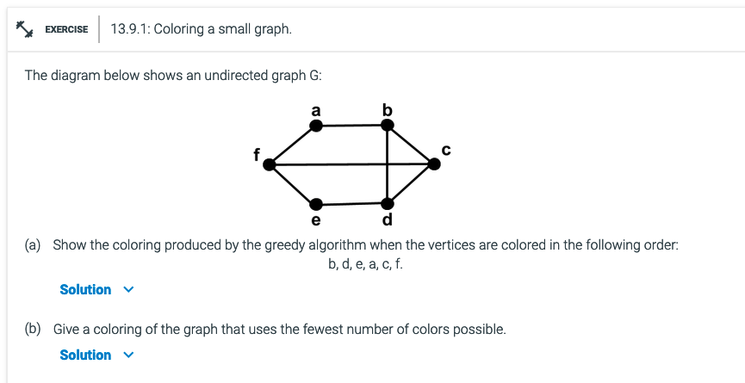
Additional exercises
13.9.1

Slide 33
Ramsey Theory
Studies the conditions under which order must appear
Complete disorder is impossible. There is order in chaos given a large enough set.
In graph form: Given a large enough complete graph, if we color the edges with two colors, we are guaranteed to find a monochromatic complete sub-graph of any size.
For example:
What is the minimum number of people in a group such that at least three of them are either acquainted or not acquainted?

Slide 34
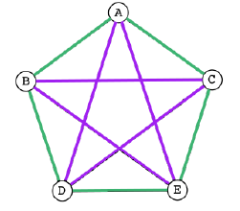
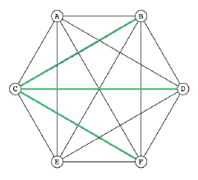
Ramsey Theory
If we color the edges of a graph using two different colors, can we do it without creating a monochromatic triangle?

Slide 35
Bipartite Graphs
Can be used to model applications that involve matching elements of one set to elements of another
Example:
Customers and Products
Employees to job assignments
Students to classes
Marriages between men and women in a village

Slide 36
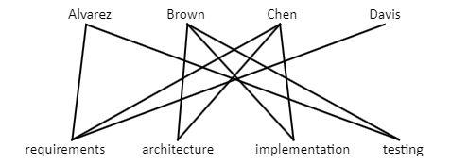
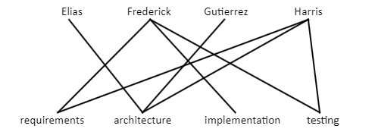

Bipartite Graphs
Example:
Assigning jobs to employees
Suppose there are $m$ employees and $n$ different jobs that need to be done where $m≥n$. Each employee is trained to do one or more of these $n$ jobs. We can use a graph to help assign employees to jobs for which they are trained.
Rosen, Kenneth. Discrete Mathematics and Its Applications, 7th Edition. McGraw-Hill, 2012

Slide 37

Bipartite Graphs
Prove whether each is bipartite or not:
$C_{3}, C_{4},C_{5},C_{6},C_{7}$
$K_{4}$

